Slide 1
Demystifying Big Data Technologies and Solutions for the Cloud
aka.ms/RocAzure
May 2018
Trey Talbott Mike McKechney Anthony Martin
trey.talbott@microsoft.com michael.mckechney@microsoft.com anthma@microsoft.com
@treytalbott @mmckechney @SQLMartini

Slide 2
Agenda
Opening Remarks
RocAzure Charter
Introductions
First timers.
Review Calendar
What’s new?
Azure Updates and Roadmap
Keynote
Wrap up and Network

Slide 3
Rochester User Group Charter
Salesy
Stuff
Cloud computing is a journey.
This User Group exists to:
Serve a community of Azure enthusiasts
Demystify cloud computing concepts
Help accelerate your cloud journey
Stay current on Azure capabilities
Help each other with the journey
Share real world experiences and lessons learned

Slide 4
Introduction of first timers
Please share your:
Name and background
Cloud experience, if any
Azure, AWS, Google, etc…
What are your expectations being here
i.e., how can this group help you?
Fun fact

Slide 5
Upcoming Events
User Groups
June 13 – TBD
July 11 – TBD
Other notable events
May 25th – GDPR goes into effect
Sept 24-28th Microsoft Ignite, Orlando

Slide 6
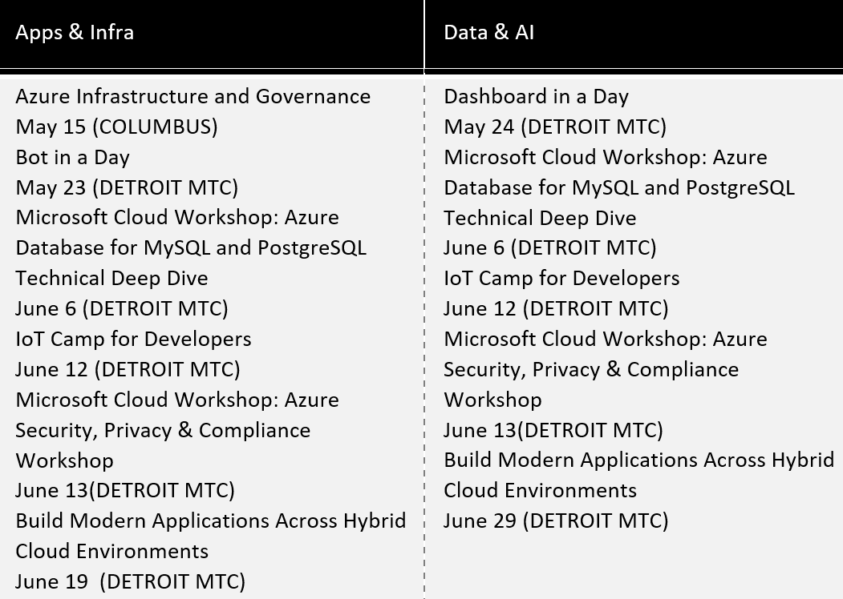
Upcoming Events
Detroit MTC Events

Slide 7
Azure Training and Certification
New learning resources: https://aka.ms/azure-learning
Learning Paths
Advanced skills
Certification
Azure learning paths by job functions to build practical job skills
For technical professionals:
On-premises IT
Hybrid IT
Developers (.NET, Node.js)
AWS professionals
Advanced training provided by Learning Partners
For technical professionals:
Wanting deeper learning
Starting a new IT role
Companies requiring training for IT teams
Microsoft Certified Professional (MCP) exam bundle aligned to job roles
For technical professionals:
Seeking to validate their skills
Needing high-value credential to demonstrate achievement

Slide 8
Staying Current
azure.com/updates
azure.com/blog
azure.com/roadmap

Slide 9
What is Big Data?
Traditional RDBMS Architectures
Big Data Architectures
SMP vs MPP
Hadoop
Data Lakes
Lambda architecture
NoSQL
Why Cloud for Big Data
Mapping to Azure Services
Questions and Wrap Up

Slide 10
What is Big Data?
The V’s
Variety: It can be structured, semi-structured, or unstructured
Velocity: It can be streaming, near real-time or batch
Volume: It can be 1GB or 1PB
Value!

Slide 11
Big Data Architectures
Designed to handle
Ingestion
Processing
Analytics
Storage/Serving
When
Too large
Too complex
For
Traditional database systems

Slide 12
Traditional RDBMS Workloads
Transactional Data (OLTP)
Record business events
CRM, ERP, LOB applications
Optimized for small read and write transactions
Data Warehousing (DW)
Centralize and integrate one or more source systems
For reporting and analytics
Online Analytical Processing (OLAP)
Increase read throughput and concurrency
Define semantic model to ease end user exploration

Slide 13
Basic Analytics Architecture
Designed to process end-to-end within a given SLA

Slide 14
Analytics Solutions- 3 Core Requirements
Interactive Query Performance
Query Concurrency
Data Volume (Scale)

Slide 15
Evolution of Big Data into DW solutions
Bottlenecks start to appear
Problem #1 – Data Volume bottlenecks both ends
Increased data volume puts pressure on SMP ingestion and queries
Data minimization / incremental scheduling / over engineered ETL
Interactive Query Performance
Query Concurrency
Data Volume

Slide 16
SMP vs MPP
SMP - Symmetric Multiprocessing
Multiple CPUs used to complete individual processes simultaneously
All CPUs share the same memory, disks, and network controllers (scale-up)
All SQL Server implementations up until now have been SMP
Mostly, the solution is housed on a shared SAN
Uses many separate CPUs running in parallel to execute a single program
Shared Nothing: Each CPU has its own memory and disk (scale-out)
Segments communicate using high-speed network between nodes
MPP - Massively Parallel Processing

Slide 17


MPP Logical Overview
Query
Result
Control
Compute
Storage

Slide 18
Evolution of Big Data into DW solutions
Bottlenecks solved via Big Data “v1” - MPP
Solution # 1 – Parallelize Everything
Migrate to MPP Platforms (APS, Teradata, Neteeza, Greenplum, Vertica)
Massive Parallel Processing
Interactive Query Performance
Query Concurrency (mostly)
Data Volume

Slide 19
Evolution of Big Data into DW solutions
More Speed == More Data == More Problems
Problem #2
Scaling MPP starts getting expensive
Concurrency, data variety, and dev time challenges
Massive Parallel Processing
Interactive Query Performance
Query Concurrency
Data Volume

Slide 20
Evolution of Big Data into DW solutions
Offload DW tasks to Big Data
Solution #2 - Hadoop
HDFS provides low cost storage alternative
Commercial RDBMS vendors deliver connectivity

Slide 21

HDFS
HDFS is a distributed file system
From a few nodes to thousands of nodes
Files can be spread out over multiple nodes
HDFS stores large amounts of data
Very large files are supported including those larger than the capacity of a single node
HDFS stores non-relational files
Server
Server
Files
Server
Server

Slide 22

MapReduce
Takes processing to where data is
Distributed processing: instead of serializing processing through one pipe, distributes computing locally where data is
Brings back only the resultant data
Scales linearly as you add nodes
Three-step execution
Map: Developer writes map functions to the data
Shuffle / Distributes: Framework automatically shuffles for you (networking, synchronization, recovery, scheduling)
Reduce: Developer writes reduce functions to bring resultant data back
Input Domain
// Map Reduce function in JavaScript
var map = function (key, value, context) {
var words = value.split(/[^a-zA-Z]/);
for (var i = 0; i < words.length; i++) {
if (words[i] !== "")
context.write(words[i].toLowerCase(),
1);}
}};
var reduce = function (key, values, context) {
var sum = 0;
while (values.hasNext()) {
sum += parseInt(values.next());
}
context.write(key, sum);
};
Map
Map
Map
Shuffle
Shuffle
Shuffle
Reduce
Reduce
Reduce
Shuffle
Reduce
Output domain

Slide 23
Data lake is the center of a big data solution
A storage repository, usually Hadoop, that holds a vast amount of raw data in its native format until it is needed.
Inexpensively store unlimited data
Collect all data “just in case”
Store data with no modeling – “Schema on read”
Complements EDW
Frees up expensive EDW resources
Quick user access to data
ETL Hadoop tools
Easily scalable
Place to backup data to
Place to move older data

Slide 24
Data Analysis Paradigm Shift
OLD WAY: Structure -> Ingest -> Analyze
NEW WAY: Ingest -> Analyze -> Structure
This solves the two biggest reasons why may EDW projects fail:
Too much time spent modeling when you don’t know all of the questions your data needs to answer
Wasted time spent on ETL where the net effect is a star schema that doesn’t actually show value

Slide 25
Comparing Data Warehousing and Data Lake
Data Lake | Data Warehouse
Complementary to DW | Can be sourced from Data Lake
Schema-on-read | Schema-on-write
Physical collection of uncurated data | Data of common meaning
System of Insight: Unknown data to do experimentation / data discovery | System of Record: Well-understood data to do operational reporting
Any type of data | Limited set of data types (ie. relational)
Skills are limited | Skills mostly available
All workloads – batch, interactive, streaming, machine learning | Optimized for interactive querying
Both are needed!

Slide 26
What about Velocity?
The V’s
Variety: It can be structured, semi-structured, or unstructured
Velocity: It can be streaming, near real-time or batch
Volume: It can be 1GB or 1PB
Value!

Slide 27
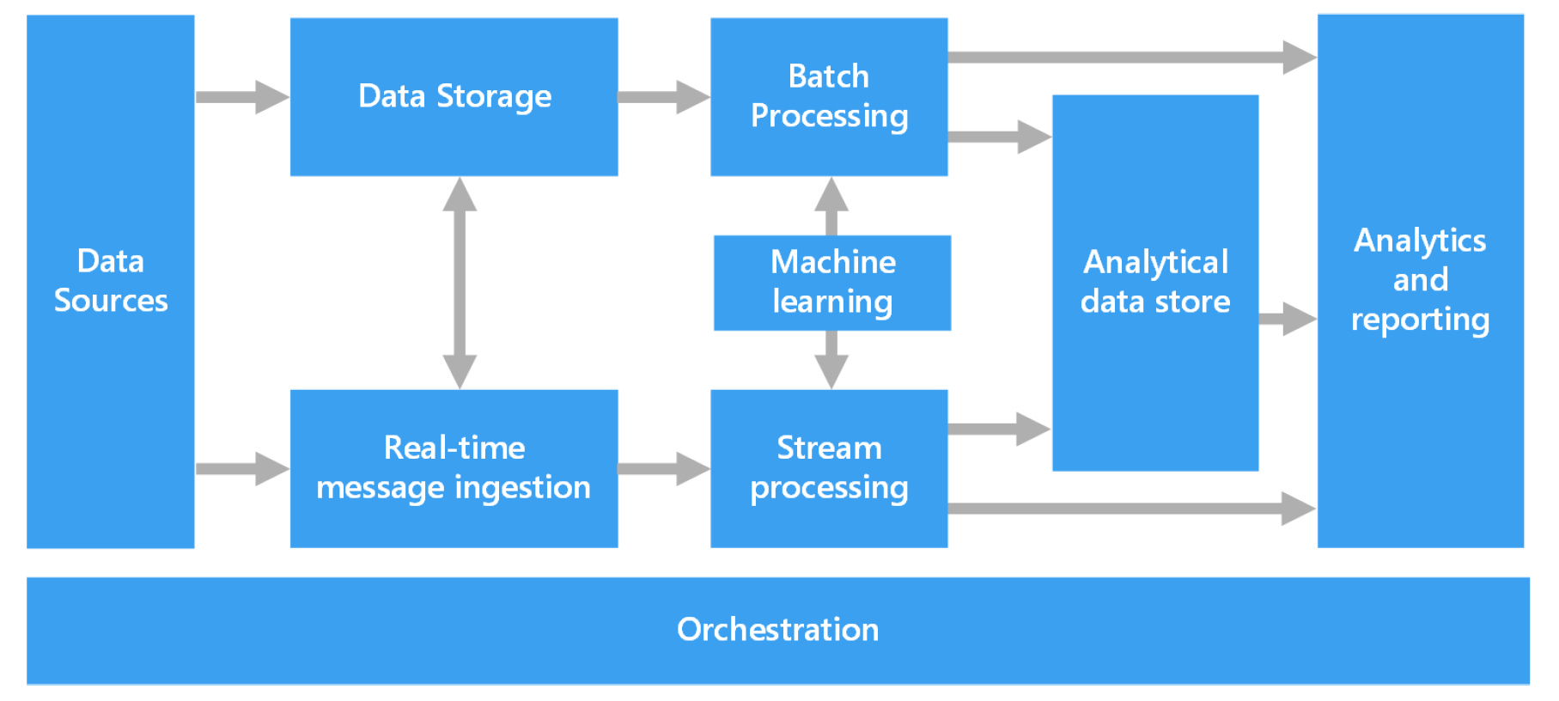
Components of a Big Data Architecture

Slide 28




Event Ingestion Patterns
Azure
Stream Analytics
Business apps
Azure
Stream Analytics
Events
Azure Event Hubs
Events
Events
Power BI
Custom apps
Kafka
Spark Streaming
Events
Event Collection
Stream Processing
Event Processing
ADLS
Sensors and devices

Slide 29
Why Cloud for Big Data?

Slide 30
Benefits of the cloud
Agility
Unlimited elastic scale
Pay for what you need
Innovation
Quick “Time to market”
Technology is changing rapidly
Fail fast
Risk
Availability
Reliability
Security

Slide 31
Who manages what?
On Premises
Physical / Virtual
Infrastructure
as a Service
Platform
as a Service
Software
as a Service
You manage
Applications
Applications
Applications
Applications
You scale, make resilient and manage
You scale, make
resilient & manage
Data
Data
Data
Data
Runtime
Runtime
Runtime
Runtime
Scale, Resilience and management by Microsoft
Middleware
Middleware
Middleware
Scale, Resilience and management by Microsoft
Middleware
O/S
O/S
O/S
O/S
Virtualization
Virtualization
Managed by Microsoft
Virtualization
Virtualization
Servers
Servers
Servers
Servers
Storage
Storage
Storage
Storage
Networking
Networking
Networking
Networking
Windows Azure
Virtual Machines
Windows Azure
Cloud Services

Slide 32
Azure Services for Big Data

Slide 33
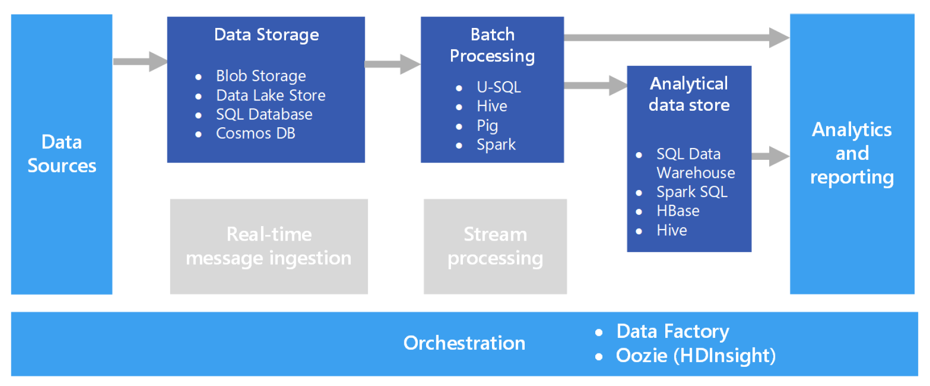
Azure Services for Batch Processing

Slide 34
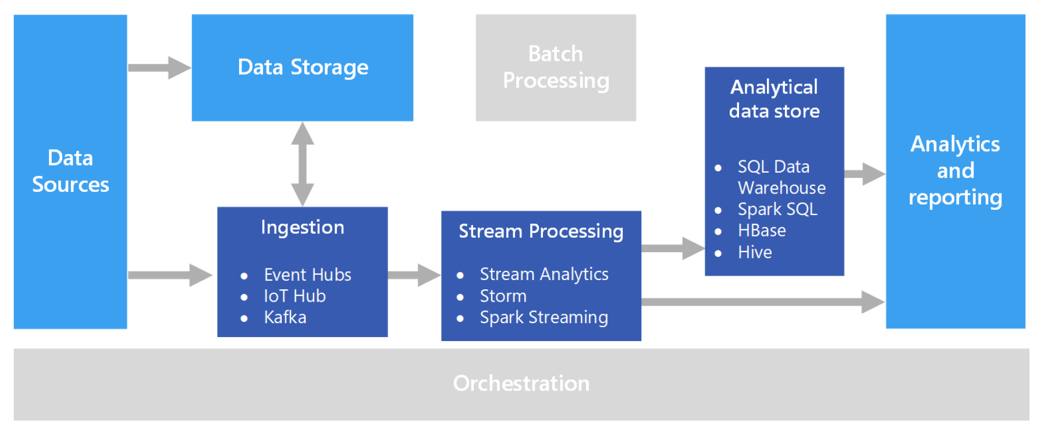
Azure Services for Stream Processing

Slide 35
Real time advanced analytics
INGEST
STORE
PREP & TRAIN
MODEL & SERVE
Azure Machine Learning
SQL Machine Learning
Logs, files and media
(unstructured)
Azure IoT Hub
Azure HDInsight (Kafka)
Azure HDInsight
Sensors and IoT
(unstructured)
Cold Path
Azure Databricks
Hot Path
Business/custom apps
(Structured)
Operational Reports
&
Analytical Dashboards (PowerBI)
Azure Data Factory
Azure Blob Storage
Azure SQL Data Warehouse
Azure Analysis Services

Slide 36
Resources
Azure Data Architecture Guide
https://docs.microsoft.com/en-us/azure/architecture/data-guide/

